Slide 1
Advanced CNN
Василий Сафронов
ФКН ВШЭ
Slides credit: Grigory Sapunov
Курс “Современный анализ данных”

Slide 2
Использование CNN для других задач
Трансформация изображений (перенос стиля, синтез изображений, …)
Обработка видео (spatio-temporal …) https://arxiv.org/abs/1606.04698
Обработка пространственных данных http://www.microsoft.com/en-us/research/wp-content/uploads/2016/09/DeepST-SIGSPATIAL2016.pdf
Обработка звука (ASR, WaveNet, …) http://benanne.github.io/2014/08/05/spotify-cnns.html https://deepmind.com/blog/wavenet-generative-model-raw-audio/ http://ronan.collobert.com/pub/matos/2015_cnnspeech_interspeech.pdf http://www.microsoft.com/en-us/research/publication/convolutional-neural-networks-for-speech-recognition-2/
Обработка текстов (классификация, перевод(!), …) http://www.wildml.com/2015/11/understanding-convolutional-neural-networks-for-nlp/ https://arxiv.org/abs/1611.02344

Slide 3
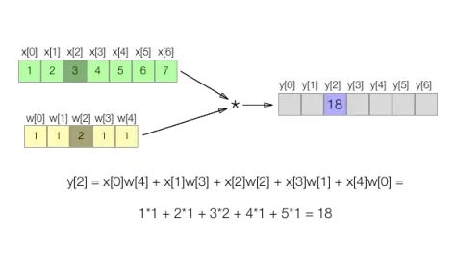
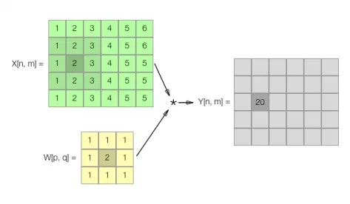
1D Convolution
1D
2D
https://www.invasivecode.com/weblog/convolutional-neural-networks-ios-10-macos-sierra/

Slide 4
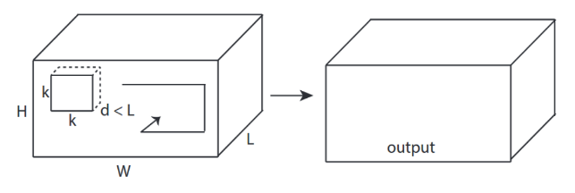
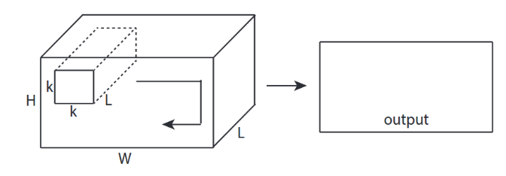
3D Convolution
3D conv.
2D conv. with channels
https://stackoverflow.com/questions/42883547/what-do-you-mean-by-1d-2d-and-3d-convolutions-in-cnn

Slide 5
Convolutions in Keras
keras.layers.Conv1D Input: 3D tensor with shape: (batch_size, steps, input_dim) Output: 3D tensor with shape: (batch_size, new_steps, filters)
keras.layers.Conv2D 2D convolution layer (e.g. spatial convolution over images). Input: 4D tensor with shape: (samples, channels, rows, cols) Output: 4D tensor with shape: (samples, filters, new_rows, new_cols)
keras.layers.Conv3D Input: 5D tensor with shape: (samples, channels, conv_dim1, conv_dim2, conv_dim3) Output: 5D tensor with shape: (samples, filters, new_conv_dim1, new_conv_dim2, new_conv_dim3)
https://keras.io/layers/convolutional/

Slide 6
Детекция: R-CNN, Fast R-CNN, Faster R-CNN

Slide 7
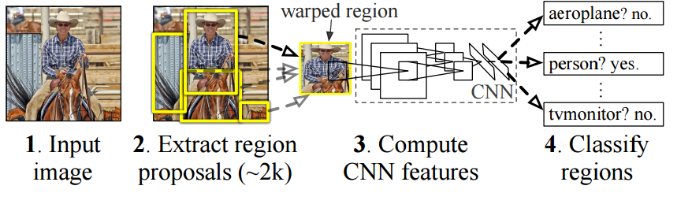
R-CNN: Region-based Convolutional Network
http://nbviewer.jupyter.org/github/BVLC/caffe/blob/master/examples/detection.ipynb
https://github.com/rbgirshick/rcnn
https://people.eecs.berkeley.edu/~rbg/papers/pami/rcnn_pami.pdf
Notes:
http://nbviewer.jupyter.org/github/BVLC/caffe/blob/master/examples/detection.ipynb
https://github.com/rbgirshick/rcnn
https://people.eecs.berkeley.edu/~rbg/papers/pami/rcnn_pami.pdf

Slide 8
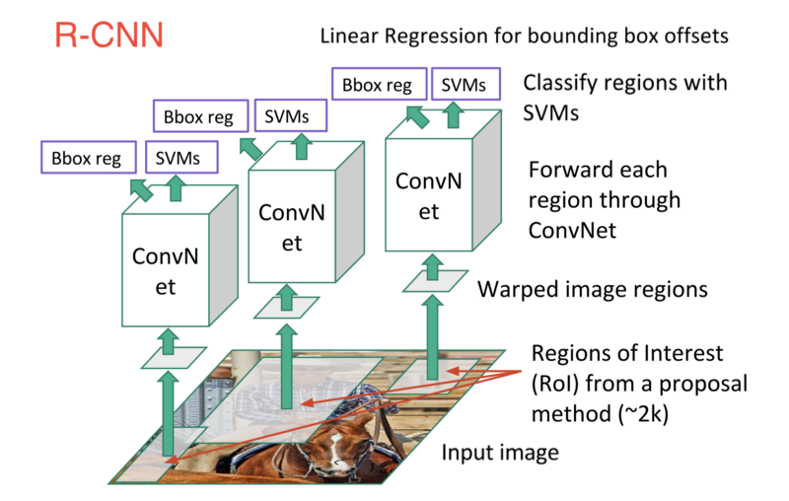

Slide 9
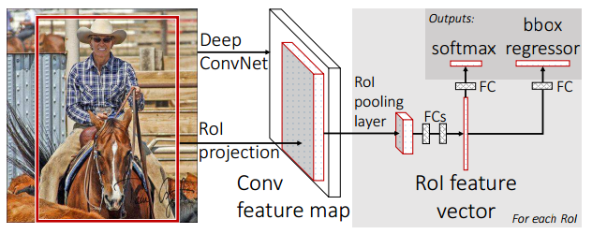
Fast R-CNN
Идея:
Перенести selective search на feature maps свёрточных слоёв (экономим на вычислениях)
Заменить SVM на Softmax
http://tutorial.caffe.berkeleyvision.org/caffe-cvpr15-detection.pdf
Notes:
https://stackoverflow.com/questions/43430056/what-is-roi-layer-in-fast-rcnn

Slide 10
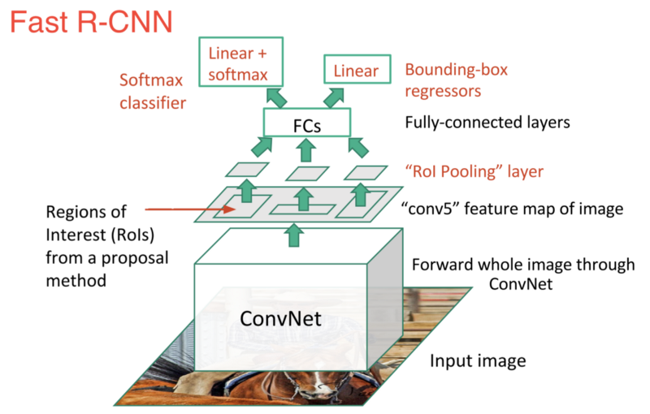

Slide 11
Faster R-CNN
Идея:
Отказаться от selective search вообще и заменить это на нейросеть region proposal network (RPN)
Работа RPN:
Скользящим окном обходим финальные feature maps свёрточной сети
В каждом окне предсказываем k стандартных bounding boxes (anchor boxes со своими соотношениями сторон) с центром в текущей позиции
Дополнительно к каждому предсказанию выдаём степень уверенности сети в том, что в этом окне есть объект
Далее отправляем результат RPN в другую сеть, которая
Уточняет границы
Делает классификацию
https://github.com/ShaoqingRen/faster_rcnn
Notes:
http://www.slideshare.net/ssuser416c44/faster-rcnn

Slide 12
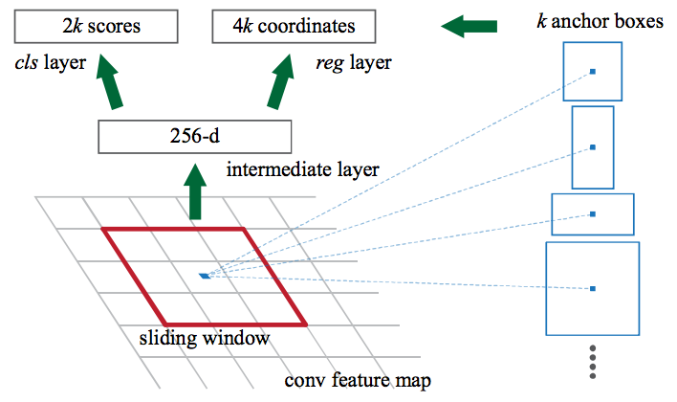
Faster R-CNN

Slide 13
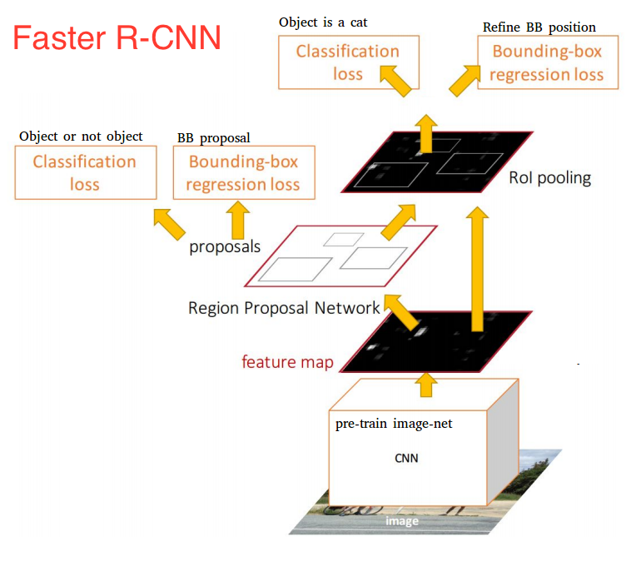

Slide 14
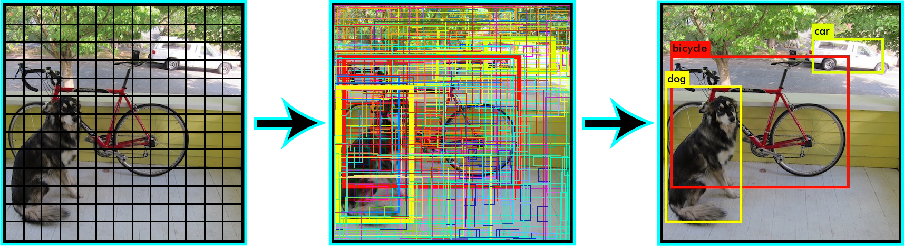
YOLO: Real-Time Object Detection
https://www.youtube.com/watch?v=VOC3huqHrss
https://pjreddie.com/darknet/yolo/

Slide 15
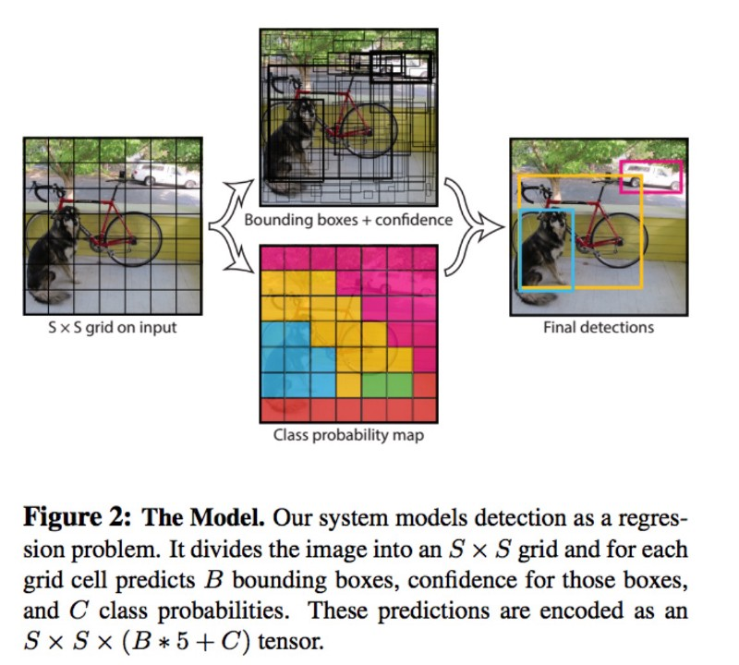
Notes:
https://towardsdatascience.com/yolo-you-only-look-once-real-time-object-detection-explained-492dc9230006
https://medium.com/diaryofawannapreneur/yolo-you-only-look-once-for-object-detection-explained-6f80ea7aaa1e

Slide 16
Ресурсы
Deep Learning for Object Detection: A Comprehensive Review https://towardsdatascience.com/deep-learning-for-object-detection-a-comprehensive-review-73930816d8d9
A Brief History of CNNs in Image Segmentation: From R-CNN to Mask R-CNN https://blog.athelas.com/a-brief-history-of-cnns-in-image-segmentation-from-r-cnn-to-mask-r-cnn-34ea83205de4
Object detection with TensorFlow https://www.oreilly.com/ideas/object-detection-with-tensorflow https://github.com/tensorflow/models/tree/master/research/object_detection
https://github.com/yhenon/keras-frcnn https://github.com/rykov8/ssd_keras

Slide 17
Fully-convolutional networks (FCN)

Slide 18
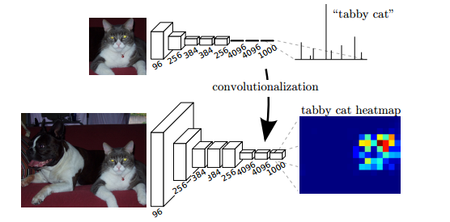
Fully-convolutional networks (FCN)
Обычная свёрточная сеть, но без MLP сверху (нет полносвязных слоёв).
Позволяет работать с изображениями произвольного размера и выдавать на выходе тепловую карту классификации.
https://arxiv.org/abs/1411.4038

Slide 19
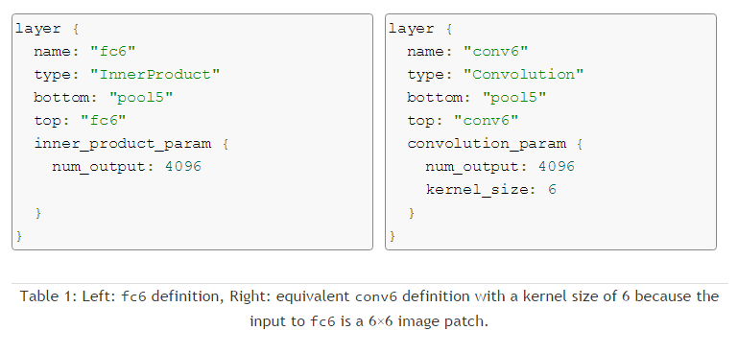
Fully-convolutional networks (FCN)
Можно преобразовать полносвязный слой на свёрточный
https://devblogs.nvidia.com/parallelforall/image-segmentation-using-digits-5

Slide 20
Ресурсы
https://people.eecs.berkeley.edu/~jonlong/long_shelhamer_fcn.pdf
https://github.com/shelhamer/fcn.berkeleyvision.org
https://github.com/developmentseed/caffe-fcn
https://www.quora.com/How-is-Fully-Convolutional-Network-FCN-different-from-the-original-Convolutional-Neural-Network-CNN
https://www.quora.com/What-are-the-advantages-of-Fully-Convolutional-Networks-over-CNNs
https://www.quora.com/How-does-the-conversion-of-last-layers-of-CNN-from-fully-connected-to-fully-convolutional-allow-it-to-process-images-of-different-size

Slide 21
Deconvolution networks

Slide 22
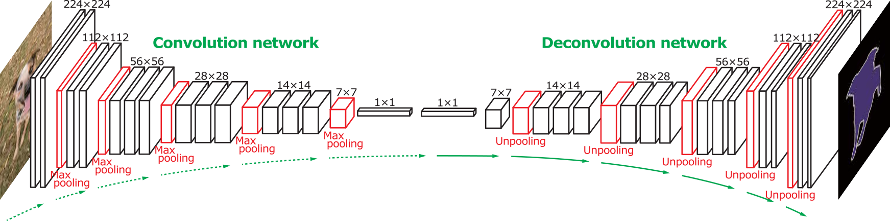
Deconvolution networks
Правильнее называть это Transposed convolution, а не Deconvolution (это слово уже занято в цифровой обработке сигналов для обратной операции).
По сути, реализован обучаемый upsampling.
http://cvlab.postech.ac.kr/research/deconvnet/
Notes:
http://stackoverflow.com/questions/35049197/how-does-the-unpooling-and-deconvolution-work-in-deconvnet
https://www.quora.com/What-is-the-difference-between-Deconvolution-Upsampling-Unpooling-and-Convolutional-Sparse-Coding
https://arxiv.org/pdf/1411.5928.pdf
http://www.matthewzeiler.com/pubs/cvpr2010/cvpr2010.pdf
https://www.quora.com/How-does-a-deconvolutional-neural-network-work

Slide 23
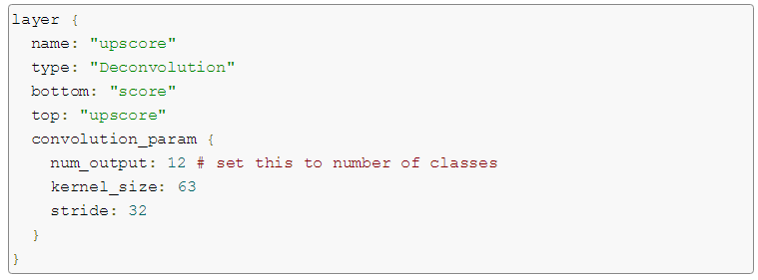
Deconvolution networks
Специальный тип слоя: Deconvolution. Параметр stride задаёт степень увеличения.
https://devblogs.nvidia.com/parallelforall/image-segmentation-using-digits-5

Slide 24

Как работает Transposed convolution
Делаем padding нулями (unpooling)
Применяем convolution

Slide 25
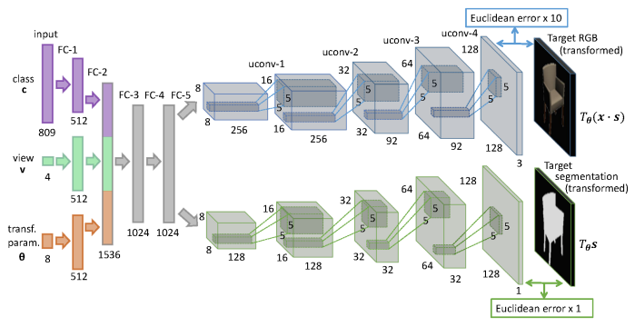
Генерация изображений
https://arxiv.org/abs/1411.5928
Notes:
https://arxiv.org/pdf/1411.5928.pdf

Slide 26
Ресурсы
https://devblogs.nvidia.com/parallelforall/image-segmentation-using-digits-5
https://github.com/vdumoulin/conv_arithmetic
https://github.com/BVLC/caffe/blob/master/include/caffe/layers/deconv_layer.hpp
https://www.quora.com/How-does-a-deconvolutional-neural-network-work
http://stackoverflow.com/questions/35049197/how-does-the-unpooling-and-deconvolution-work-in-deconvnet
Кейс с убиранием очков https://blog.insightdatascience.com/isee-removing-eyeglasses-from-faces-using-deep-learning-d4e7d935376f

Slide 27
Generative Adversarial Networks (GANs)

Slide 28
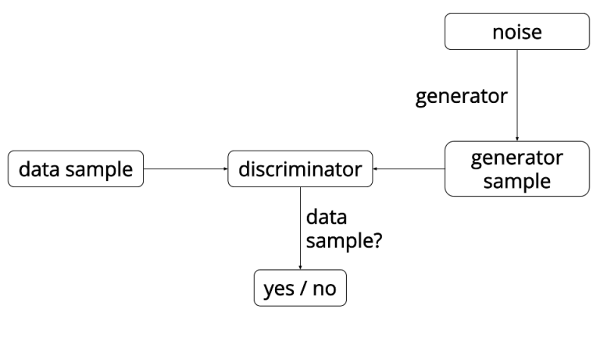
Generative Adversarial Networks (GANs)
https://arxiv.org/abs/1411.5928
Notes:
https://arxiv.org/pdf/1411.5928.pdf

Slide 29
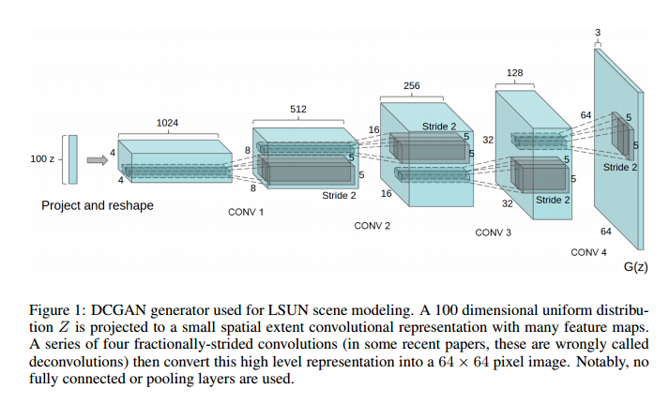
Generative Adversarial Networks (GANs)
https://arxiv.org/pdf/1511.06434v2.pdf
Notes:
https://arxiv.org/pdf/1411.5928.pdf

Slide 30
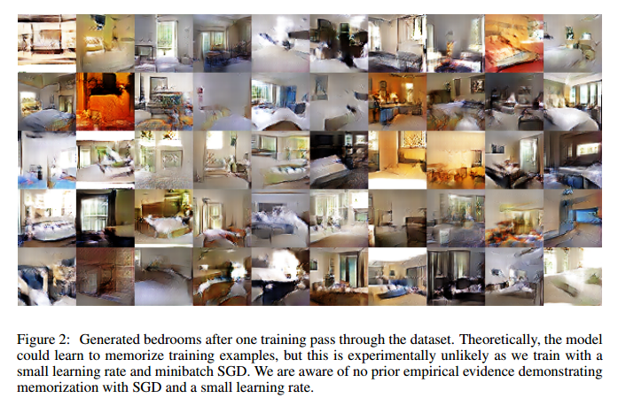
Generative Adversarial Networks (GANs)
https://arxiv.org/pdf/1511.06434v2.pdf
Notes:
https://arxiv.org/pdf/1411.5928.pdf

Slide 31
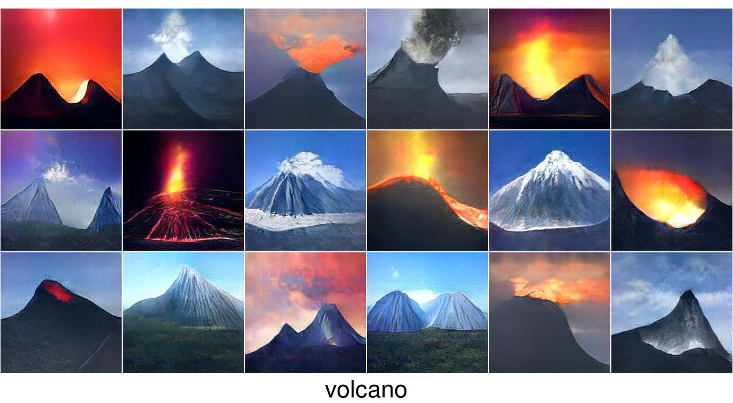
Generative Adversarial Networks (GANs)
http://www.evolvingai.org/ppgn

Slide 32
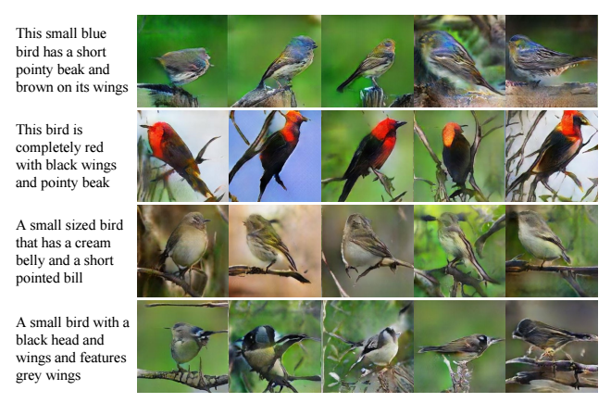
Example: StackGAN
StackGAN: Text to Photo-realistic Image Synthesis with Stacked Generative Adversarial Networks, https://arxiv.org/abs/1612.03242

Slide 33
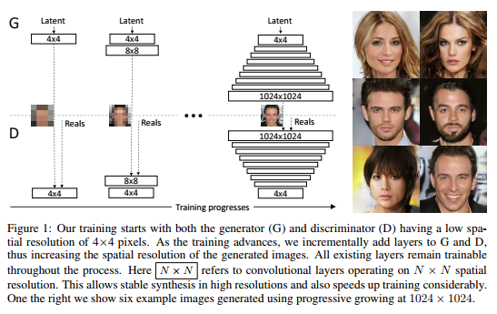
Example: Progressive Growing of GANs
Progressive Growing of GANs for Improved Quality, Stability, and Variation, https://arxiv.org/abs/1710.10196 https://www.youtube.com/watch?v=XOxxPcy5Gr4

Slide 34
Ресурсы
https://openai.com/blog/generative-models/
https://www.quora.com/What-are-Generative-Adversarial-Networks
Unsupervised Representation Learning with Deep Convolutional Generative Adversarial Networks https://arxiv.org/abs/1511.06434
http://blog.aylien.com/introduction-generative-adversarial-networks-code-tensorflow/
Plug & Play Generative Networks http://www.evolvingai.org/ppgn

Slide 35
Кейс: Перенос стиля

Slide 36
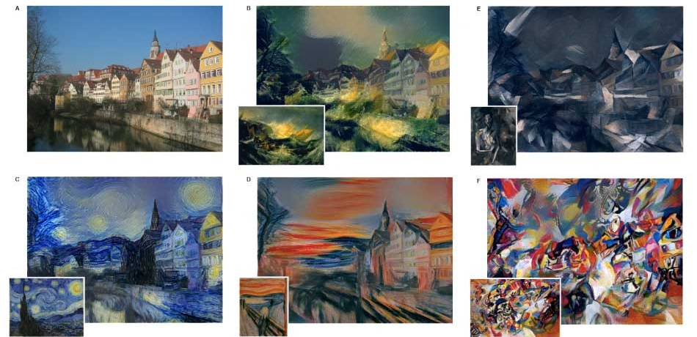
Неклассические задачи: перенос стиля
https://arxiv.org/abs/1508.06576

Slide 37
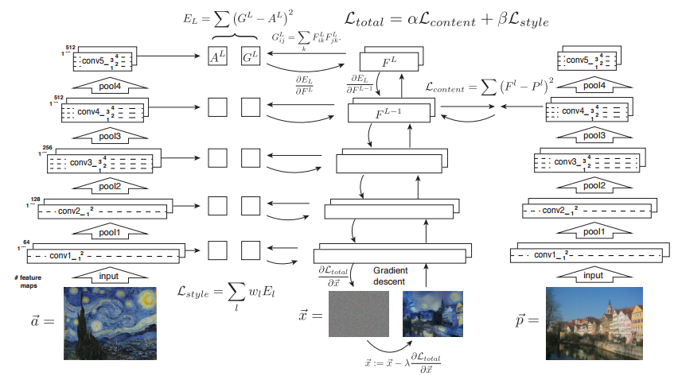
Перенос стиля: оригинальный алгоритм
https://arxiv.org/abs/1508.06576

Slide 38
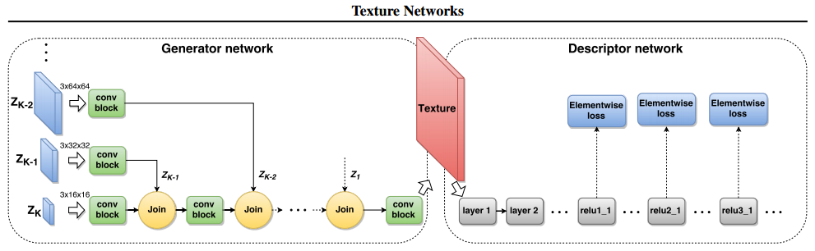
Перенос стиля: быстрый алгоритм
https://arxiv.org/abs/1603.03417
https://research.googleblog.com/2016/10/supercharging-style-transfer.html

Slide 39
Реализации
Классический алгоритм:
https://github.com/jcjohnson/neural-style (Torch)
https://github.com/fzliu/style-transfer (Caffe)
https://github.com/titu1994/Neural-Style-Transfer (Keras)
Быстрые алгоритмы:
https://github.com/jcjohnson/fast-neural-style (Torch)
https://github.com/yusuketomoto/chainer-fast-neuralstyle (Python/Chainer)
https://github.com/lengstrom/fast-style-transfer (Python/TF)
https://github.com/DmitryUlyanov/texture_nets (Torch)
Doodle:
https://github.com/alexjc/neural-doodle
Notes:
https://github.com/tensorflow/magenta/blob/master/magenta/reviews/styletransfer.md

